Slide 1
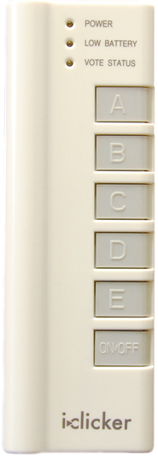
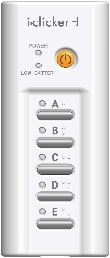
For iClicker remote users: Students in this class will use an iClicker remote. One can be purchased at the Cornell Store, or many online sites such as Kraftees, eBay or Craigslist. Any type of iClicker remote will work: iClicker, iClicker+, or iClicker2 models. How to register your iClicker remote through Blackboard: Click the above link iClicker Student Registration Type in the iClicker Remote ID on the back of your clicker Click Submit NOTE: Registering your clicker for one Blackboard course will automatically register your clicker for ALL Blackboard courses each semester. Please do not register iClickers at the iclicker.com site.
If you cannot read the clicker remote ID: To find your iClicker ID #: Please stop in to the Academic Technology Center, 124 Computing & Communications Center building (on the Ag Quad, next to Bailey Hall), between 9:00am – 5:00pm, Monday – Friday and one of the staff can confirm your iClicker ID #. Once it has been confirmed, please write it on a small piece of paper and place it inside the battery compartment.
NOTE: If you use multiple devices in any given lecture (an iClicker remote and the iClicker Reef app), you will receive points for only one of your devices.
If you have any other issues with your iClicker remote, please stop in to the Academic Technology Center, 123 Computing & Communications Center building (on the Ag Quad, near Bailey Hall), between 9:00am – 5:00pm, Monday – Friday.

