Slide 1
What is Project Management?

Slide 2
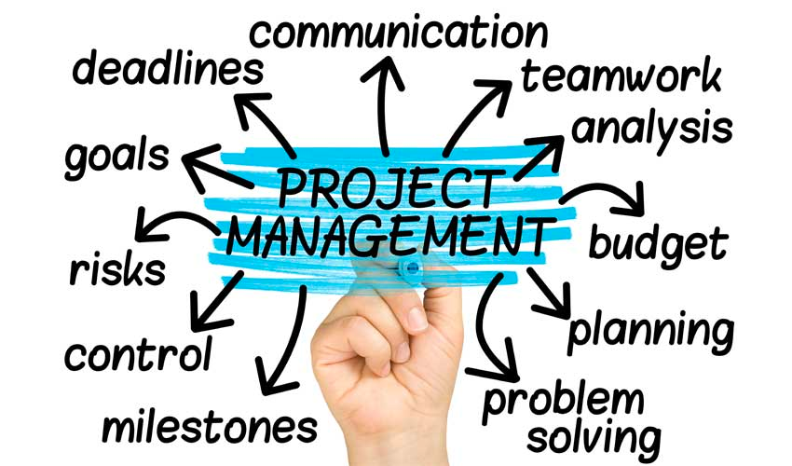
Project Management = Project Success!
Notes:
project management is something we do every day as individuals: planning and navigating the demands of schoolwork and life (PM has many dimensions, come of which are summarized above)
project management deserves special attention for team projects
Bringing other people into the mix to approach a complex project requires everyone to be on the same page from the beginning, and careful communication and coordination throughout.

Slide 3
What is project management?
4 key aspects: Plan, Process, People, Product
Q: What are some examples of projects you have helped manage?
Notes:
modern project management: comes to use from engineering fields in the 1950’s
today: used in almost every discipline
Every project has 4 key aspects: Plan-- deciding what to do Process-- deciding how to do it People-- determining who will do what and l communication Product-- deliverables of the project
Post in the chat some of the projects you’ve helped manage!
example:: Let’s say you were going on an impromptu camping trip this weekend goal: go camping, have fun, and come back safe and in one piece As an individual, the steps you’d take towards accomplishing this goal is intuitive -- divide it into a set of tasks, and would order those tasks in a way that would make most sense for you based on your instincts prior experiences (or perhaps you might consult with an outside expert) BUT -- if we were to say-- we are going to go on a class camping trip this weekend: * more people involved: more tasks can get done (divide and conquer), more shared experience and knoweldge designing and executing the plan becomes more complex (tasks can be accomplished at the same time by different people) more people to manage, more safety considerations
what would it take? -- shared vision of the project goals, understanding the constraints -- team member coordination, regular communication -- breaking project into manageable tasks that individuals can accomplish -- synchronization (deciding what to do when in an efficient manner)
QUESTION FOR DISCUSSION (turn to a neighbor, random zoom break-out-rooms, or post in zoom chat):
”What are some examples of projects you have helped manage?”

Slide 4
What are some project management challenges?
Achieving project goals within a set of constraints
Notes:
Today and next week, we’ll be working to addressing four of the biggest challenges inherent to project management:
First-- achieving project goals within a set of constraints: ( let’s take some time to identify some of this Capstone project’s constraints, and some strategies for working within those constraints)

Slide 5
Project Constraints
What are some of the constraints exist for this capstone project?
What are some general strategies for achieving goals within these constraints?
TIME: -- length of project is limited to the semester: setting reasonable goals -- schedules of teammates: outlining what days are more free/busy -- Points of Contact: come with questions ready!
PERSONEL: -- setting achievable goals in small groups -- working efficiently -- not getting bogged down in details
RESOURCES: -- access to historical records -- technical details may be challenging to understand (domain knowledge)
Q: Can you recommend strategies for achieving goals within these constraints?
Notes:
Let’s discuss potential project constraints:
some examples
TIME: time in semester, time in a day, time/availability of POCs
PERSONEL: small groups-- setting achievable goals, working efficiently, not getting bogged down in details,
RESOURCES: access to historical records, technical details/language may be challenging to understand (domain knowledge)
QUESTION FOR DISCUSSION (turn to a neighbor, random zoom break-out-rooms, or post in zoom chat):
”Can you recommend any strategies for achieving goals within some of these constraints?”

Slide 6
What are some project management challenges?
Achieving project goals within a set of constraints
Establishing a shared vision
Notes:
Next challenge of PM: -- making sure that our teams have a shared vision of the project at a ‘big picture’ level (one way to do this is by project mapping)
take a moment to look at the project mapping activity you’ll be doing shortly

Slide 7
Project Mapping Activity
Why? Big Picture & Context Describe your project: - What is the big picture? - What is the motivation? | What? Overview, Constraints - What are the major dimensions of your assessment? What is your team trying to accomplish? - What constraints (time, scope, resources, etc.) do you expect you will encounter? - What factors could derail your project and how will you prevent this from happening? | For Whom? Audience - Who is the intended audience? - What outcomes are they seeking from your assessment? - What specific metrics guide their decision making? - How will you convey your results to your audience?
How? - How often will your team meet? How often do you want to meet with Pete outside of class? - How will you will you use Slack to accomplish your project goals? - Who will lead dialogue with your LSC facilities POC? - What resource needs do you have? - Who else will you need to reach out to?
Notes:
Components of the project map:
Why? Big picture and motivation for project
What? overview of the assessment you will be conducting, summary of constraints and risk-management plan
For whom? Assessment audience and communication strategy
How? → next step for the project: team coordination -- deciding logistics about meeting and communication goals -- considering what resources/contacts you will need to draw on for your assessment
(you’ll take 20 min in breakout rooms to work on the project map-- replace the prompts with your responses)
-- if you need to copy the slide for more room for your ideas/notes feel free to do so
goal of project mapping: everyone on the team to have a shared vision of the project

Slide 8
What are some project management challenges?
Achieving project goals within a set of constraints
Establishing a shared vision
Setting achievable goals
Team member coordination
Notes:
Returning to the four challenges of project management:
What remains?
-- setting achievable goals (given the constraints): (this will be an iterative process with repeated opportunities feedback)
-- Team member Coordination: once achievable goals are set-- deciding what tasks exist, who does what, and in what order
To address these last two points, we’ll take inspiration from the well-established field of Project Management for methods, tools and overall best practices;

Slide 9
Project Management Methods & Tools
Goals:
break down big tasks into smaller manageable tasks
formulate realistic time estimates for each task
determine task dependencies & ordering
visual representations & progress summaries
team awareness of project scope
Notes:
In the next few slides I’m going to summarize a few examples of PM methods, to give a broad overview of the options available and that are used broadly in many different professional contexts.
Each one takes slightly different approach, but they share similar goals:
— (list goals)

Slide 10
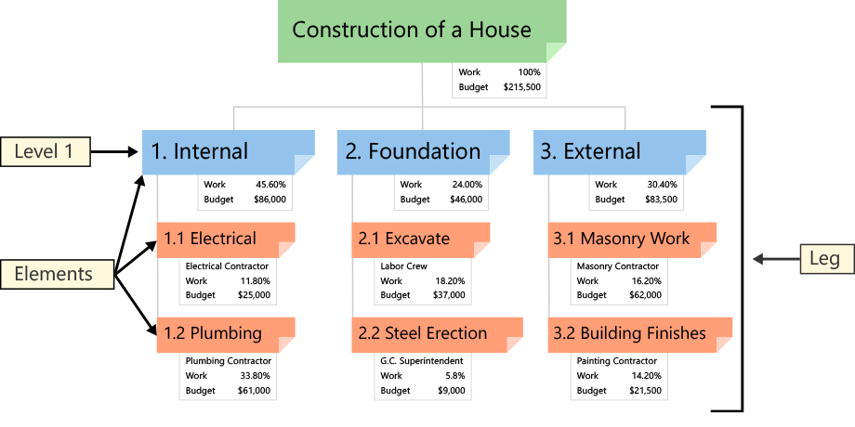
Work-Breakdown Structure (WBS)
Breaks down big projects into smaller manageable units— includes a graphic representation of every task in the project.
Notes:
www.workbreakdownstructure.com
-- the work breakdown structure: hierarchical map of all of the different tasks that contribute to the overall goal of the project: ordered into different levels, lists of steps (this example is for the construction of a house)
Great starting point--
a graphical visualization of every task within a project
widespread use by organizations in all forms of projects (construction, aerospace, software development, research projects, product development, etc)

Slide 11
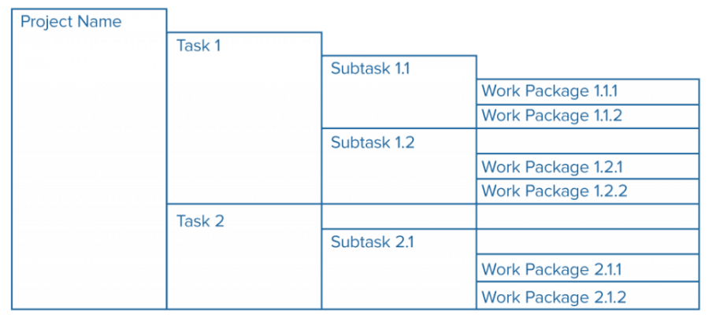
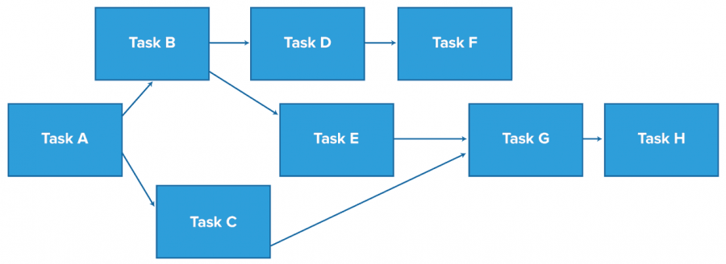
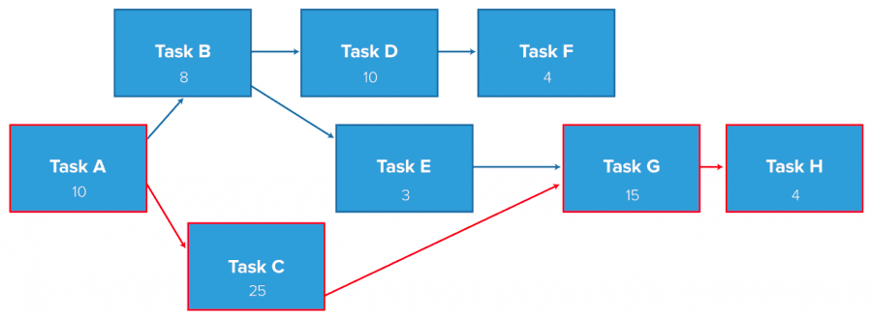
Critical Path Method
Algorithm for scheduling a set of project tasks-- constructs a project model that includes every task, duration of task, task dependencies and endpoints
1) Specify each activity
4) Estimate activity completion time
rely on past experience and knowledge of experienced team members
3-point estimation method: a = best case estimate m = most likely estimate b = worst case estimate E = ( a + m + b ) / 3
2) Establish activity sequence
3) Draw the network diagram
5) Identify the Critical Path — longest sequence of activities on the path (by time estimate)
Notes:
https://www.smartsheet.com/critical-path-method
But, how do those tasks interact?
Which tasks can be done concurrently, and which tasks have dependencies (eg. need the walls up before starting on the roof)
-the Critical Path Method: organizes small project units into a sequence of activities: -establish the activity sequence from a list of activities, arrange in a network diagram
- estimate activity completion time for each task/project draw on experience of team members and other stakeholders
find a realistic average between best/most likely and worst case estimates
- identify the critical path-- ID the path through the project units that takes the longest time (in red) come up with a realistic estimate for the project
identify any ‘choke points’ and determine important deadlines

Slide 12
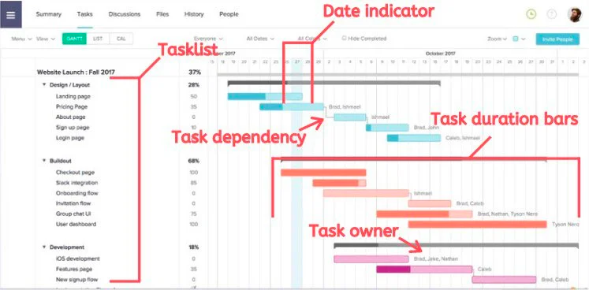
Gantt Chart
Visual timeline across the lifecycle of the project from start date to end date (includes a detailed task breakdown with individual timelines for each task)
When tasks begin and end
Who the tasks are assigned to
Any task dependencies
How long a task will take to complete
Which tasks overlap with others
The critical path for a project
Q: Have you created a Gantt Chart for a project before? If so, for what? If not, is this a tool you might find useful, and why?
Notes:
https://www.fool.com/the-blueprint/gantt-chart/
-- This critical path method can be graphically depicted as a Gantt chart--
Gantt chart = Detailed timeline across the lifecycle of the project
Ordered task list along the left edge;
Date across top of chart
Task duration bars show when the task will be initiated and completed Multiple tasks can overlap with each other
-- additional details: task dependencies, task owners
-- “one of the most widely used project management tools” today
QUESTION FOR DISCUSSION (turn to a neighbor, random zoom break-out-rooms, or post in zoom chat):
Q: Have you created a Gantt Chart for a project before? If so, for what? If not, is this a tool you think might find useful, and why?
And with that, I wanted to end with one last team coordination tool, Slack:

Slide 13
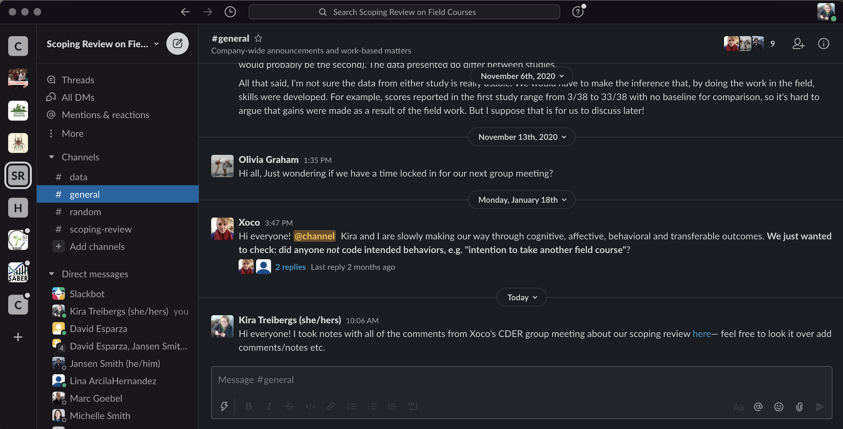
Slack
Team communication tool to replace email (browser or desktop application*) * recommended
WORKSPACE
Notes:
Ask students to indicate their experience with slack via a show of hands: ”Who has used Slack before? Who has not? “
Brief Slack overview:
Communication workspace: for efficient and directed virtual communication
specific audience groups (channels) communicate with relevant team members all in one place
Slack workspaces (accessible by a url: <workspacename.slack.com> or within the desktop/phone app [recommended, especially if you belong to multiple workspaces!]
image: of an example Slack desktop (This example is logged into 9 Slackworkspaces at the moment, 1 is highlighted here-- a project team working on a literature review project)

Slide 14
Slack
Team communication tool to replace email (browser or desktop application*) * recommended
CHANNELS
Notes:
each workspace is divided into multiple channels (indicated with the # symbol):
allow for targeted topic/group communication: <Option for instructor to share more about how this class’s Slack page will be set up >> You can search all of the channels and join those that are relevant to you and your team

Slide 15
Slack
Team communication tool to replace email (browser or desktop application*) * recommended
Notes:
The slack workspace for this class has 5 channels currently:
#general: everyone is automatically added to when they join
then you can click on your team channel to join it (and you’ll see a line in the channel indicating you’ve joined)
-- note: you can click on the + next to channels & select ‘browse channels’ to:
view all public channels in a workspace and to see a summary of the channels that you belong to

Slide 16
Slack
Team communication tool to replace email (browser or desktop application*) * recommended
WORKSPACE
* conversations viewable to entire channel
@channel to alert everyone or @individuals
Notes:
within a channel, you message using thread-based conversations -- the app displays new unread messages (you can stay caught up at your own pace) -- you can direct messages to the whole channel, or to individuals using the @ symbol
-- scroll backwards through time to see valuable documentation of all messaging, files and links shared throughout project
-- options available for apps & integration: polling, scheduling, links to other productivity tools etc.
note about free version of slack: fully functional, only limited by space (10,000 message limit, up to 10 integrations)

Slide 17
Slack
Team communication tool to replace email (browser or desktop application*) * recommended
DIRECT MESSAGING
Notes:
direct-messaging: small group/individual messaging threads
green dot next to a user shows they are available on slack (you can adjust when you are/aren’t available)

Slide 18
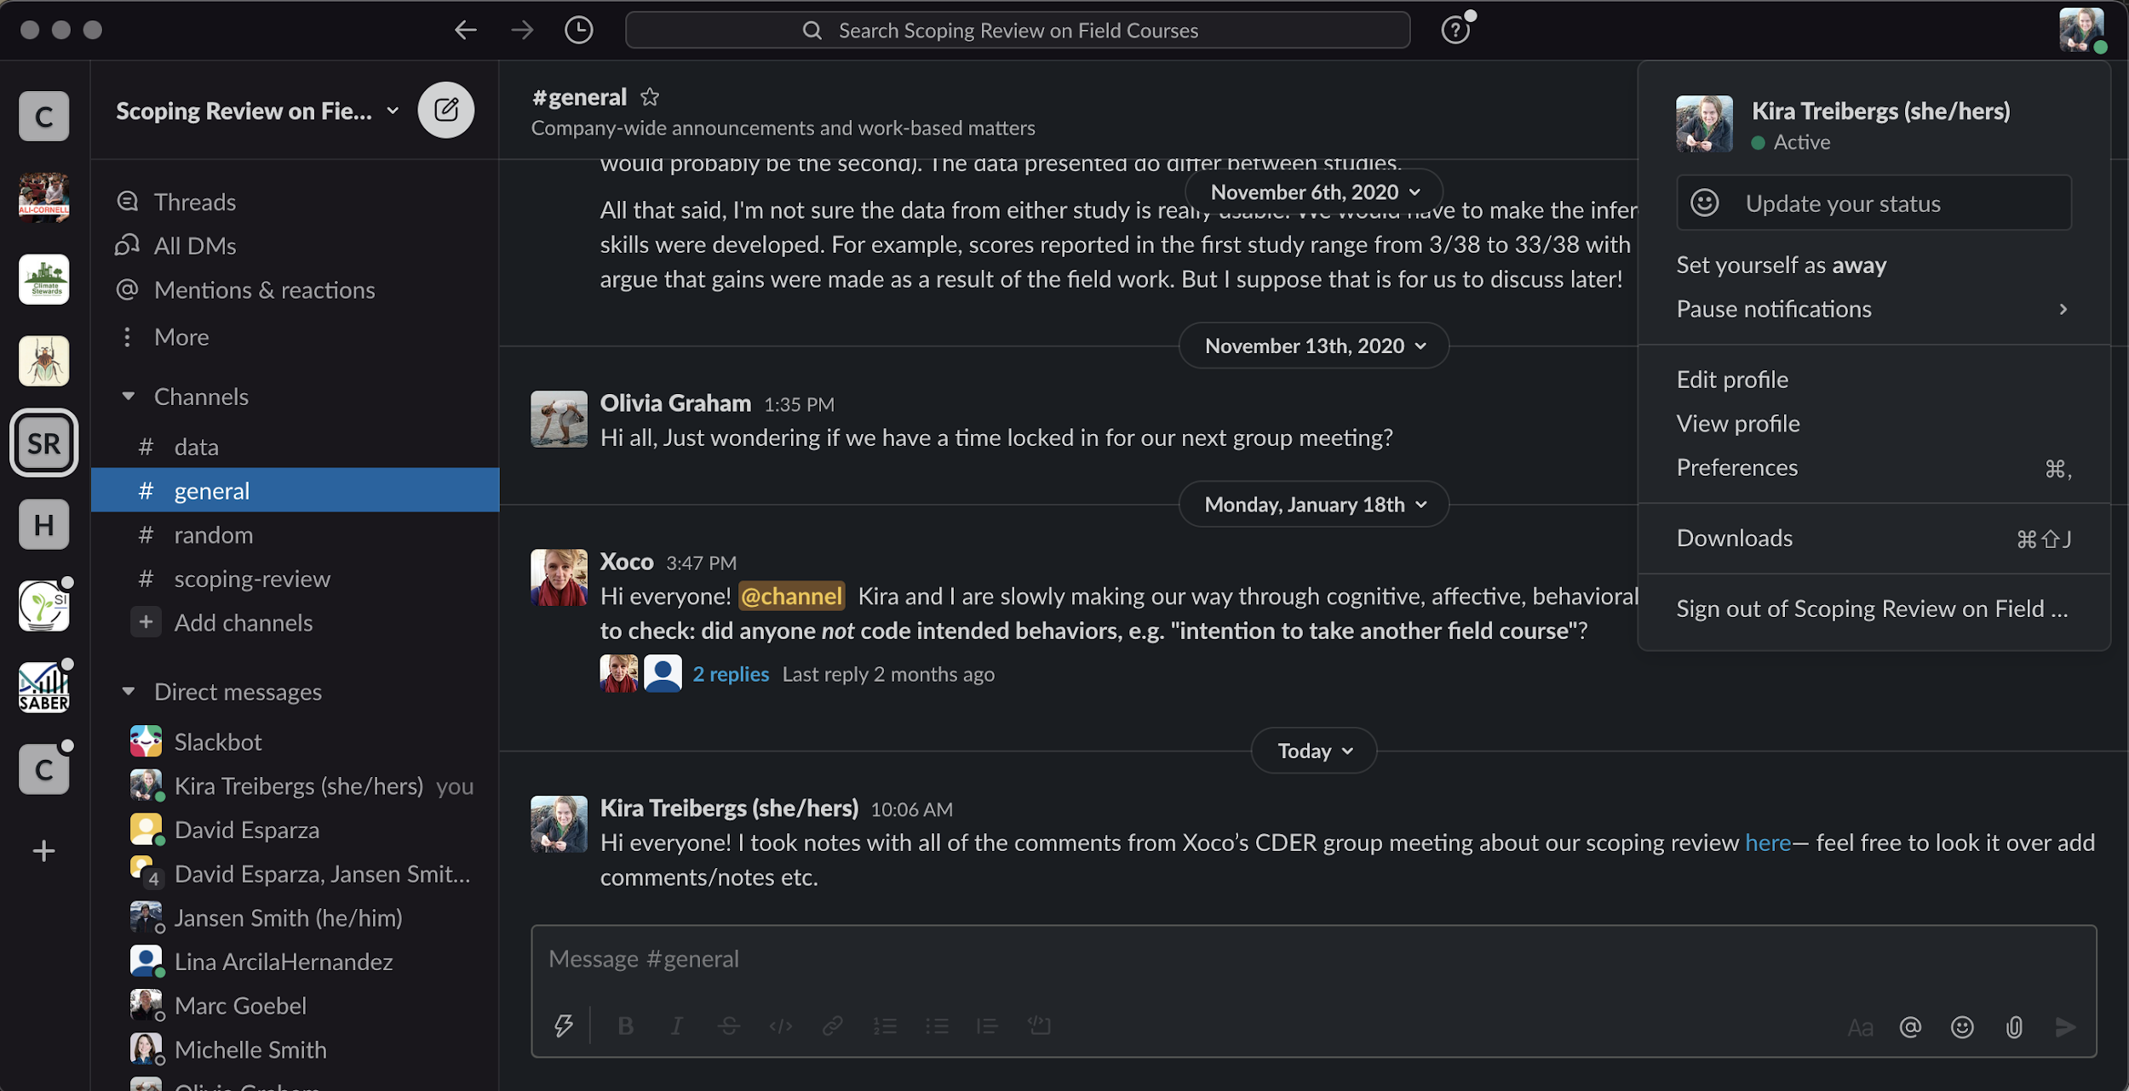
Slack
Team communication tool to replace email (browser or desktop application*) * recommended
NOTIFICATION SETTINGS
Notes:
explore the settings!

Slide 19
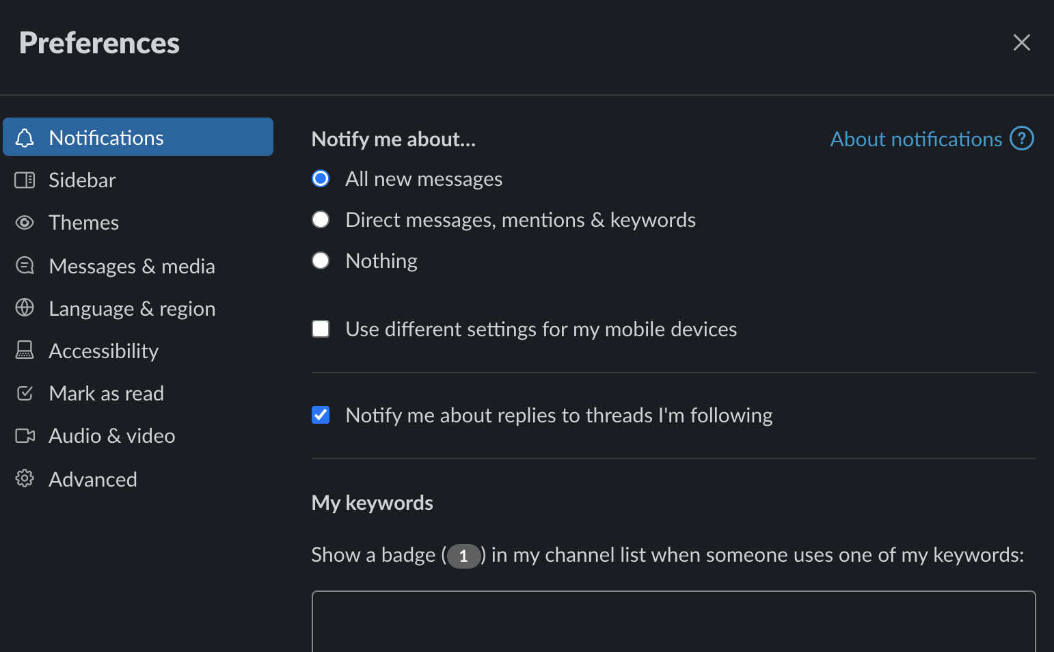
Slack
Team communication tool to replace email (browser or desktop application*) * recommended
PREFERENCES
Notes:
Preferences:
set yourself as active/away - elect when to receive notifications
other customizations

Slide 20
New to Slack?
Quick Start Guide to Slack
Your Personal Slack Settings
Setting Up Slack
Download the Slack Apps (computer/phone)
What is a workspace?
Setting up your profile
Your Profile & Preferences
Access Your Account
Manage Your Profile
Set Your Preferences
Adjust Your Notifications
Other Slack Resources
Using Slack
Work in Channels
Send Messages
Share Files and Conversations
Search
Navigating Slack
Tips & Tricks
Keep up with what’s important
Reduce noise in Slack (manage what gets your attention and what doesn’t)
Set up Slack for Work Hours
Notes:
helpful resources if you are new to Slack (I will share these slides on your classes Canvas page)

