Slide 1

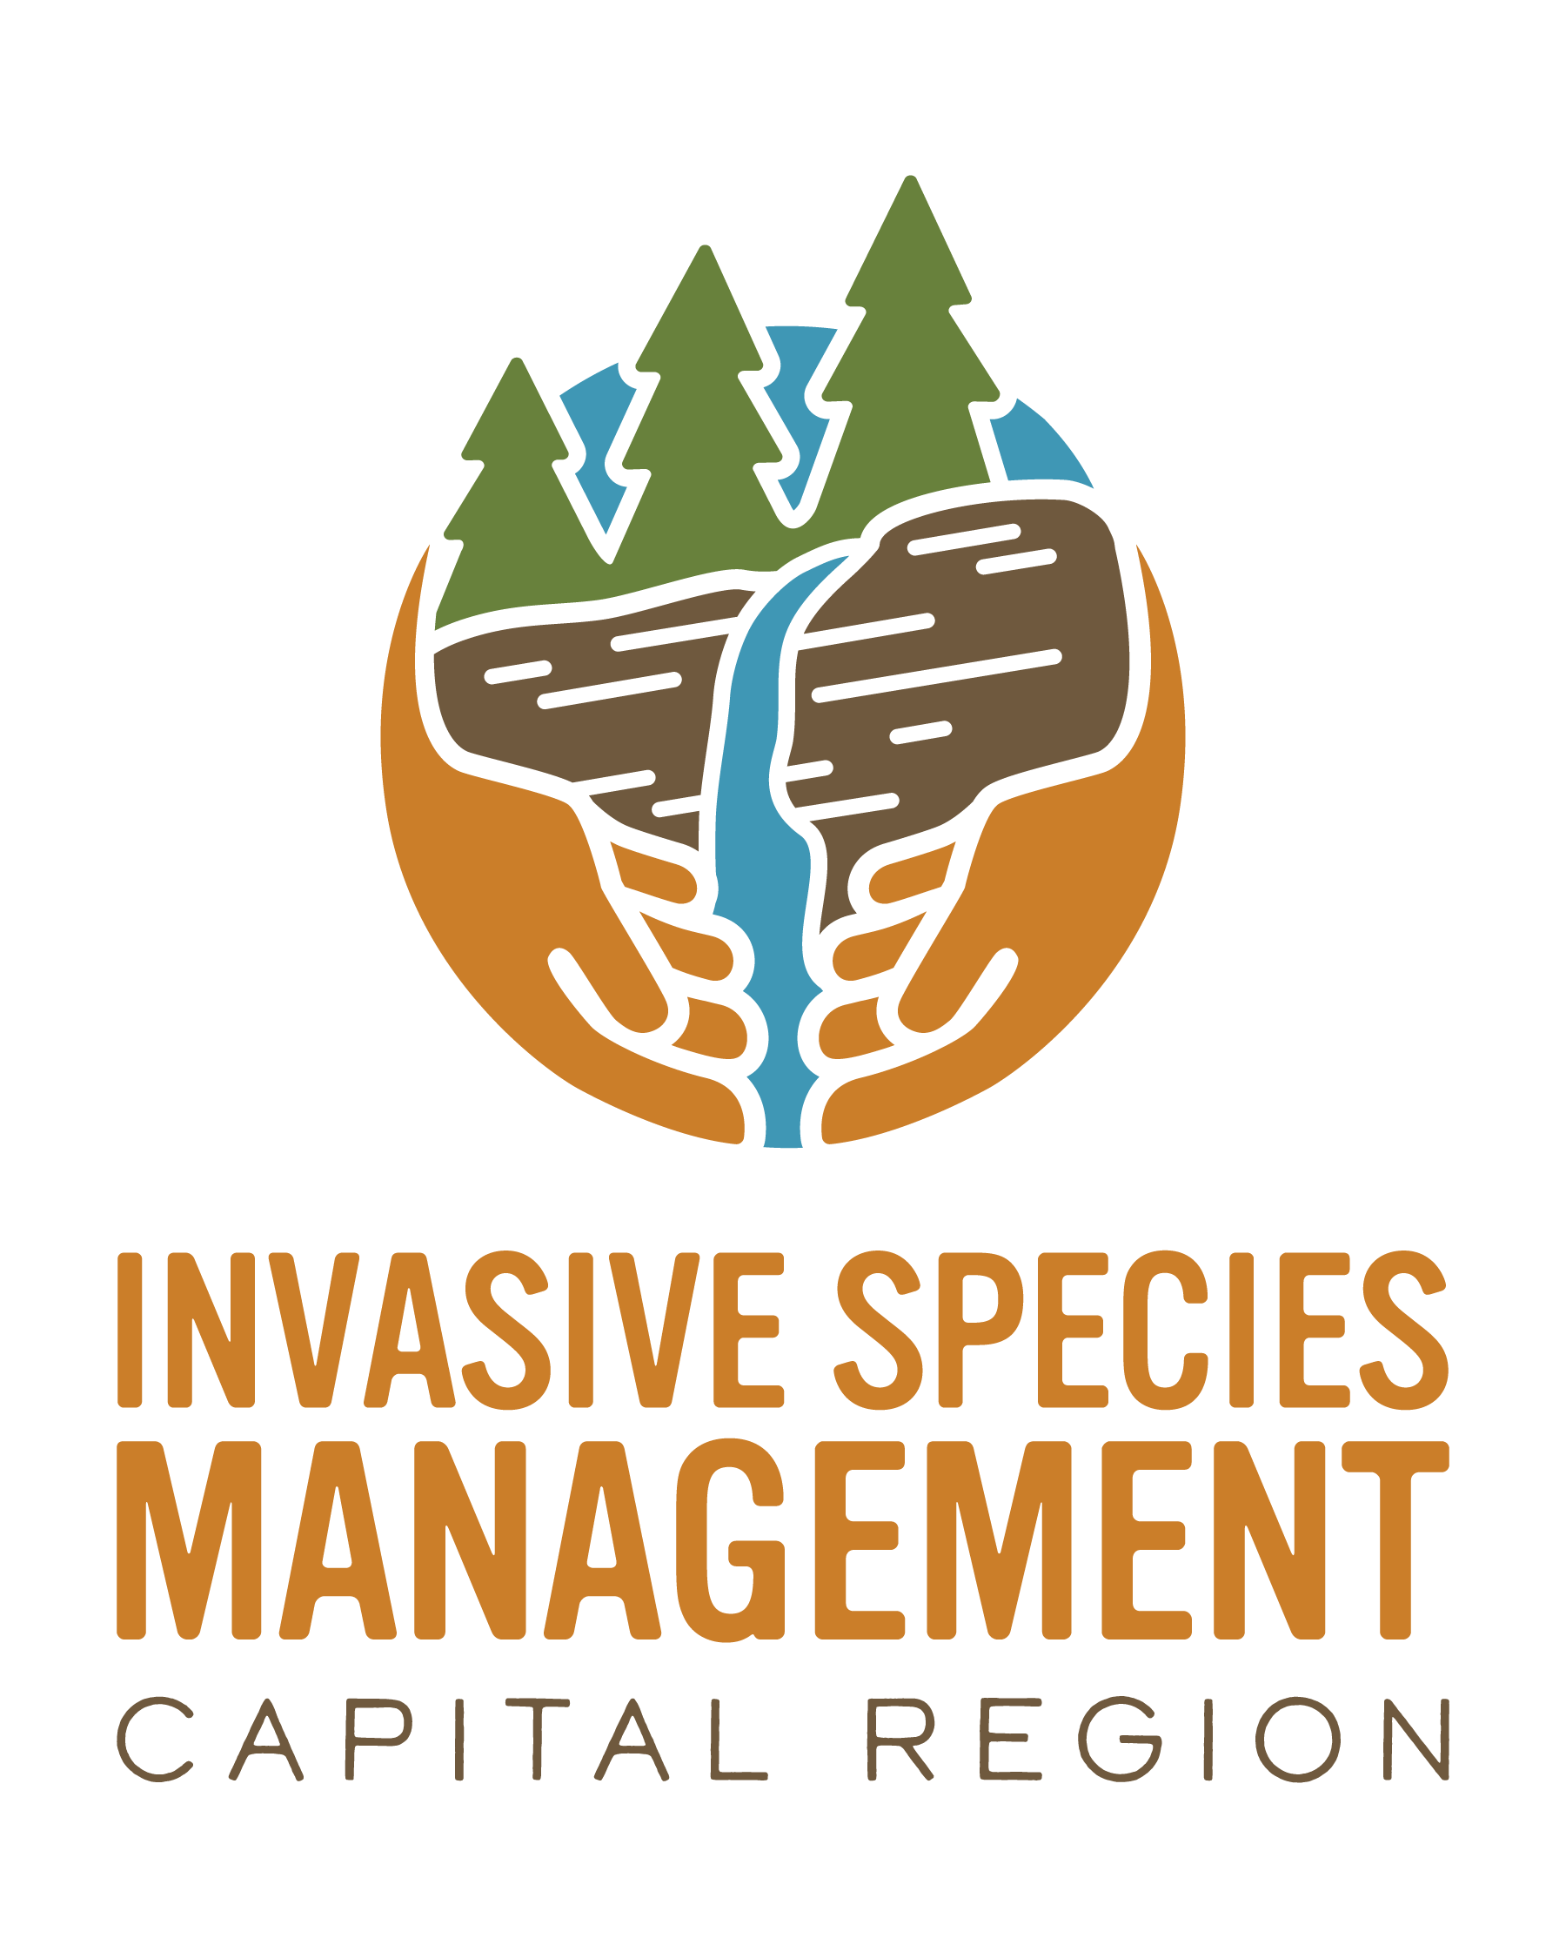
Capital Region PRISM
A Framework of Response and Prioritization
Kristopher Williams
Invasive Species Coordinator
kbw44@cornell.edu
capitalregionprism.org

Slide 2
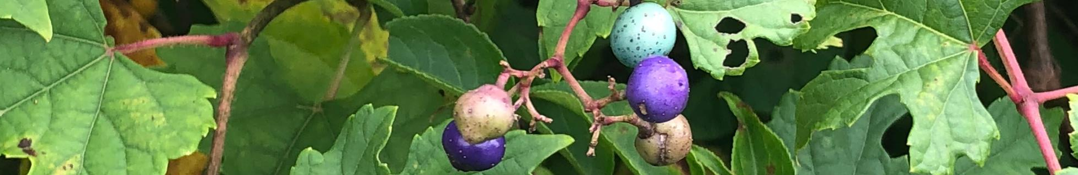
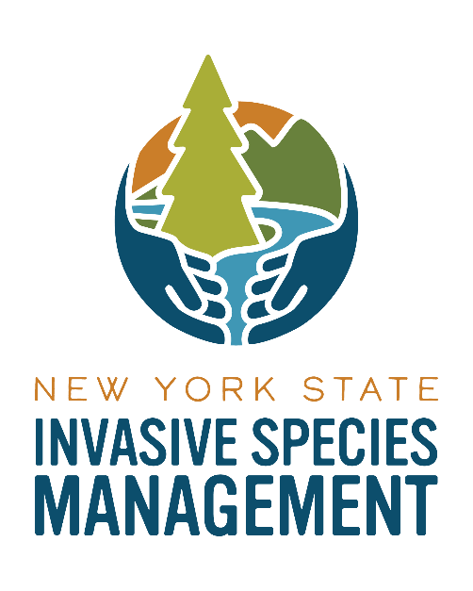
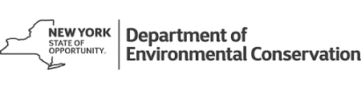

Partnerships for Regional
Invasive Species Management
New York State PRISM’s
The New York State Department of Environmental Conservation provides financial support to The Capital Region PRISM via the Environmental Protection Fund

Slide 3
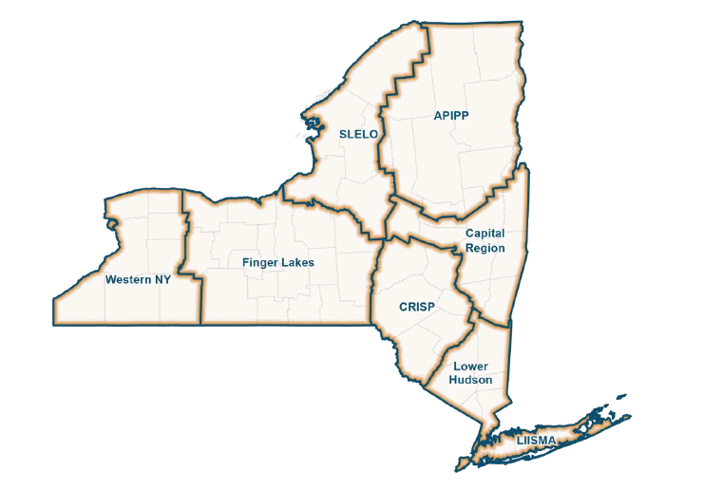

Partnerships for
Regional
Invasive
Species
Management
Notes:
The Eight PRISMS of New York State
The partnerships exist to prevent or minimize the harm caused by invasive species to our environment, quality of life, and economic wellbeing. The PRISMS are not for profit organizations and are fully funded by the NYS Environmental Protection Fund that prioritize invasive species works with partner organizations.
Due to the dynamic nature of invasive species and the vast geography’s in which the biologic pollution has spread or has the potential to spreading through our environment the PRISMS were created to help combat the harmful threats presented by invasive species. The PRISM’s work in terrestrial and aquatic habitats including urban and agricultural arenas.
Recognizing that controlling the biologic threats posed from invasive species are not a simple problem that can be cured by one group the PRISMS help coordinating partner efforts to increase the capacity in which invasive species practices are more likely to have successful outcomes. The power of collaboration is why we are here today.
The eight PRISM’s represented on the map are unique in their geography, populations, economy, and represent an assemblage of different ecoregions often spread over several counties and cover a multitude of acers. The geographies of the PRISM are divided over large scales often bordered by or representing unique regions of the state. The PRISMs span many different municipalities, state agencies, and work with a diverse set of partners to accomplish works.
APPIP and CRISP PRISMS cover a vast wilderness
Finger lakes PRISM has a geography that focuses on the central part of the state and some remarkable water bodies.
SLELO is tied to the great lakes
LIISMA Is loaded with coastal habitats metropolitan centers.
CR-PRISM, WNY-PRISM and Lower Hudson PRISM are embodied by terrestrial and aquatic habitats with large urban, agricultural and forested areas.

Slide 4
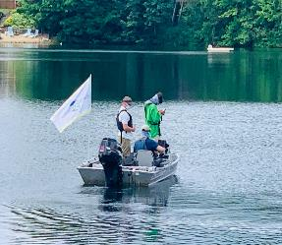
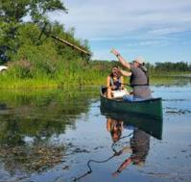

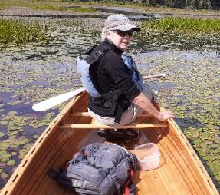
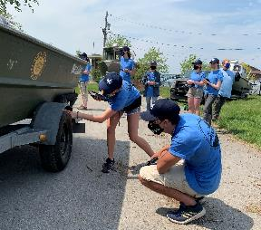
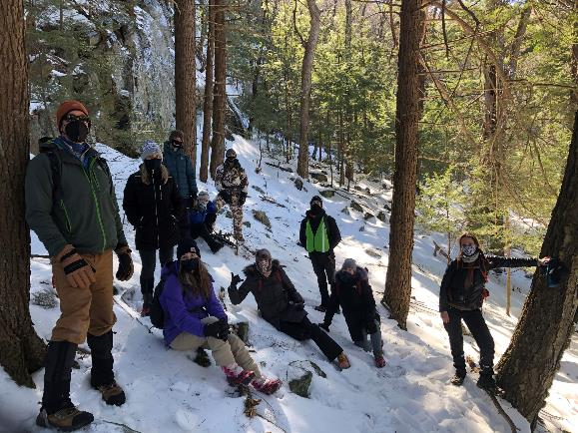
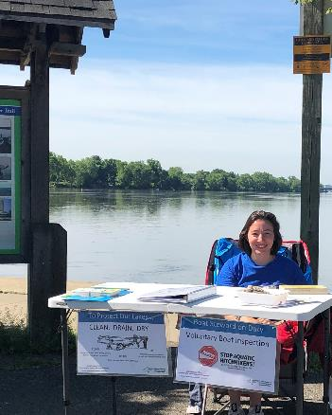
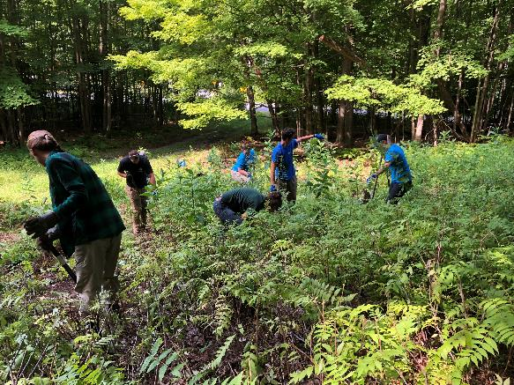
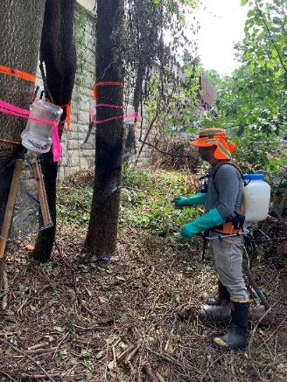
Functions of The PRISMs
  Coordinate Regional Invasive Species Activities
  Promote Prevention and Outreach Programs
  Conduct Early Detections Surveys
  Implement Control and Restoration Projects
Notes:
Each PRISM is similar in structure, staff, and deliverables while at the same time being unique to their region.
Functions of the prism
(Read the Slides)
• Establishing early detection and monitoring networks for invasive species.
• Implementing eradication and control efforts.
• Develop and implement restoration methods for areas that have been degraded by invasive species.
• Releasing funds for invasive species work through a Request for Proposals (RFP).
• Provide funds for partners with Memorandums of Understanding (MOU’s) for invasive species works.
• Aid and assist partners in developing a (Framework for Response) for invasive species management.
• Coordinating partner efforts regarding invasive species management
• Delivering prevention and education services to the public and organizations in need.
• Recruiting and training citizen scientists and volunteers with early detection and management.
________________________________________
The PRISMS and Partners are at the forefront of regional invasive species research and development of best management practices. Partners can access and contribute to our collective knowledge on regional invasive species management issues. Services that partners have benefitted from are vast and accumulative as a collective whole.

Slide 5
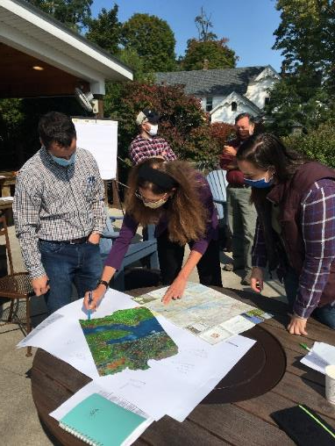
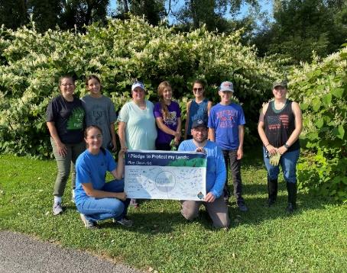
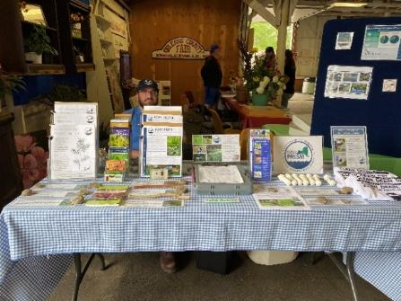
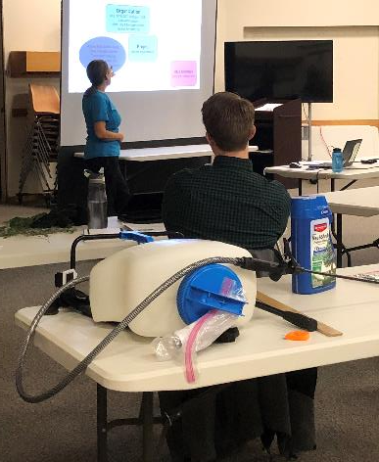


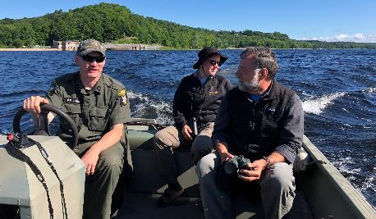
Functions of The PRISMs
  Educate Stakeholders on Invasive Species
  Coordinate PRISM Partners
  Recruit &Train Volunteers-Citizen Scientist
  Support Research Actions
  Act as Regional Communication Hubs
  Provide Funding Opportunities

Slide 6
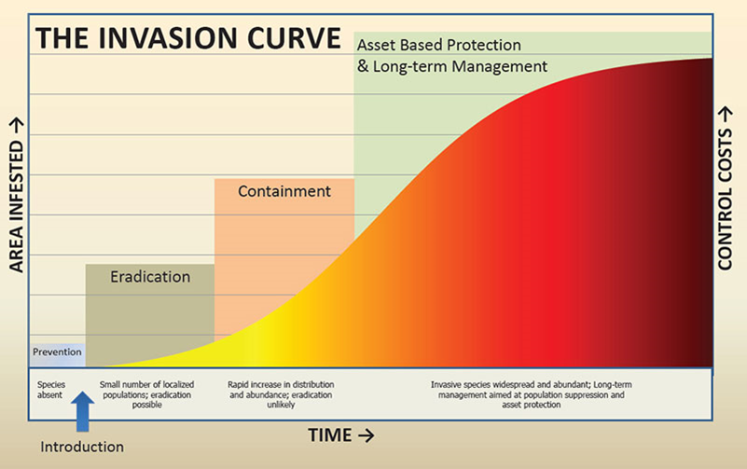
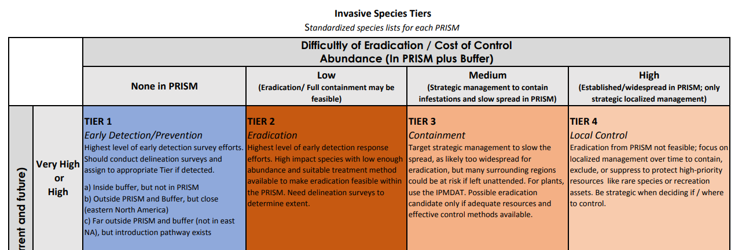
The Invasion Curve and Tier List a Foundation for Guiding Work Prioritizations
Tier 4
Tier 3
Tier 2
Tier 1
USDA Forest Service 2005 Invasive Plant Environmental Impact Statement

Slide 7
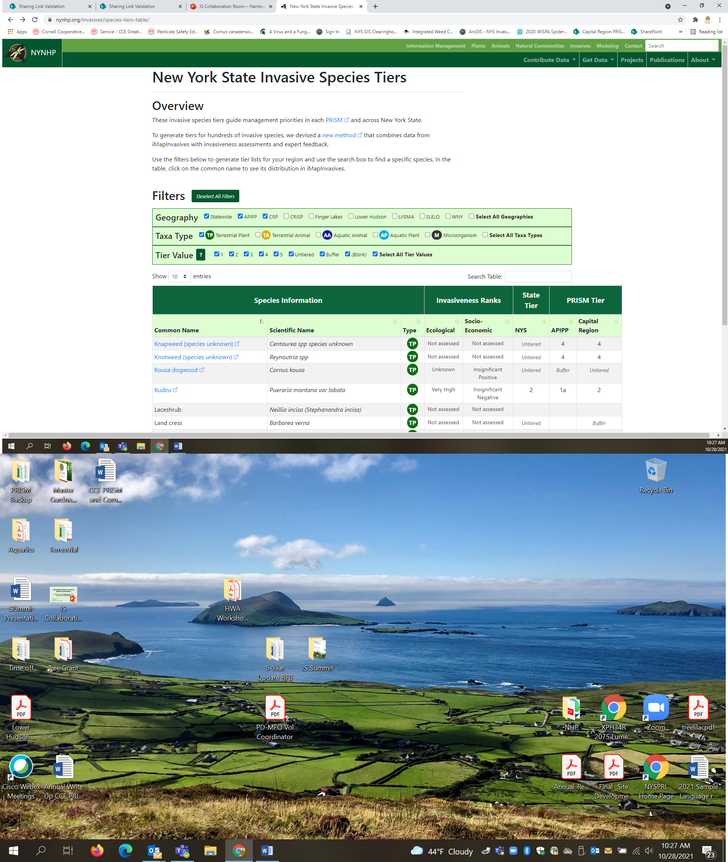
nynhp.org/invasives/species-tiers-table/

Slide 8
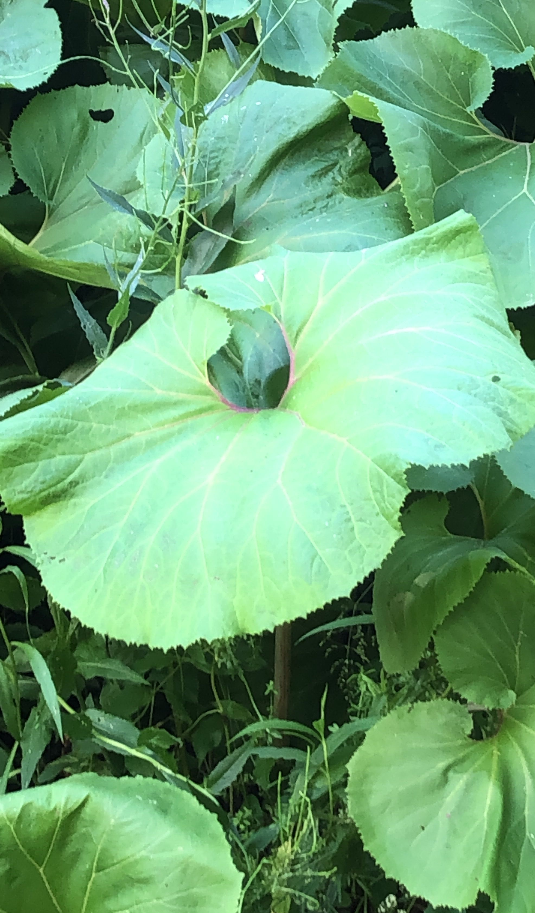
Integrated Pest Management (IPM)
Adaptive ecosystem based approach exploring multiple control options targeting invasive species to prevent, eradicate, contain, or suppress populations.
Selecting from a range of manual, mechanical, chemical, cultural and biological control methods.
The goal is to maximize effective control and to minimize negative environmental, economic, and social impacts.
IPM means using a control method(s) that reflect the available
Land use goals, Funding, Time, Values of the Community, Labor and Require Dedication Over Years
UNIVERSITY OF CALIFORNIA AGRICULTURE AND NATURAL RESOURCES
“Statewide Integrated Pest Management Program” https://www2.ipm.ucanr.edu/What-is-IPM/ 1996-2019

Slide 9
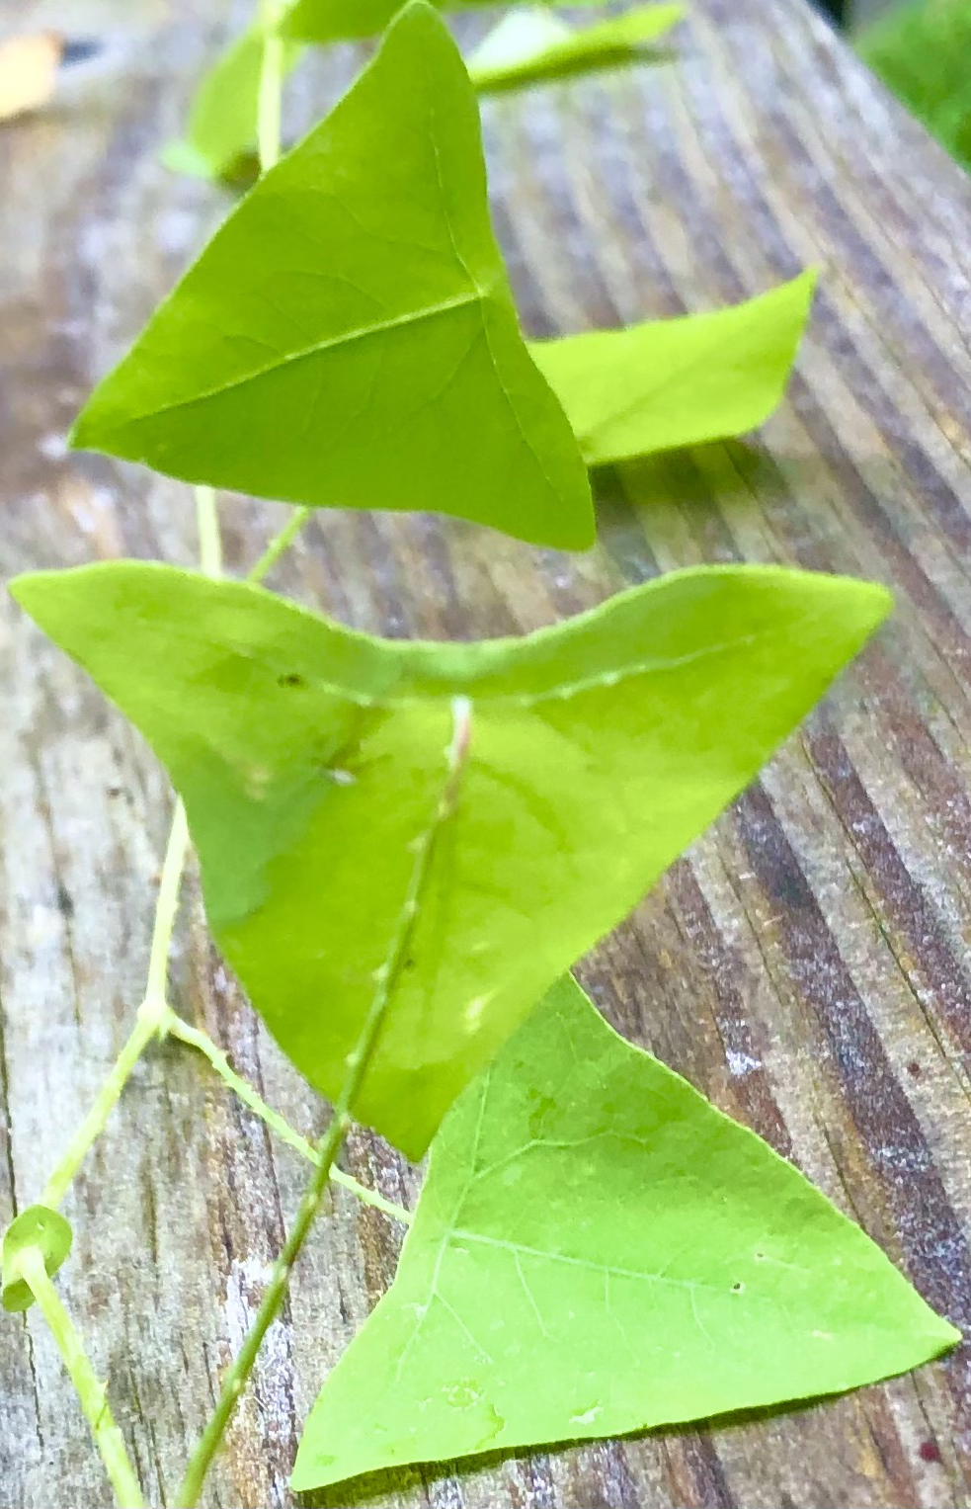
IPM Programs Combine Management Approaches for Greater Effectiveness.
Manual and Mechanical Controls
  Practices include hand pulling, grubbing, cutting, girdling, grazing, hoeing, mowing, and/or excavating. Physical controls include barrier techniques by benthic or terrestrial mats, mulches for weed management, water drawdowns and fire!
Cultural Controls
  Cultural controls are practices that reduce pest establishment, reproduction, dispersal, and survival. Limiting exposed soil at work sites and restoring the environment with a natural seed bank.

Slide 10
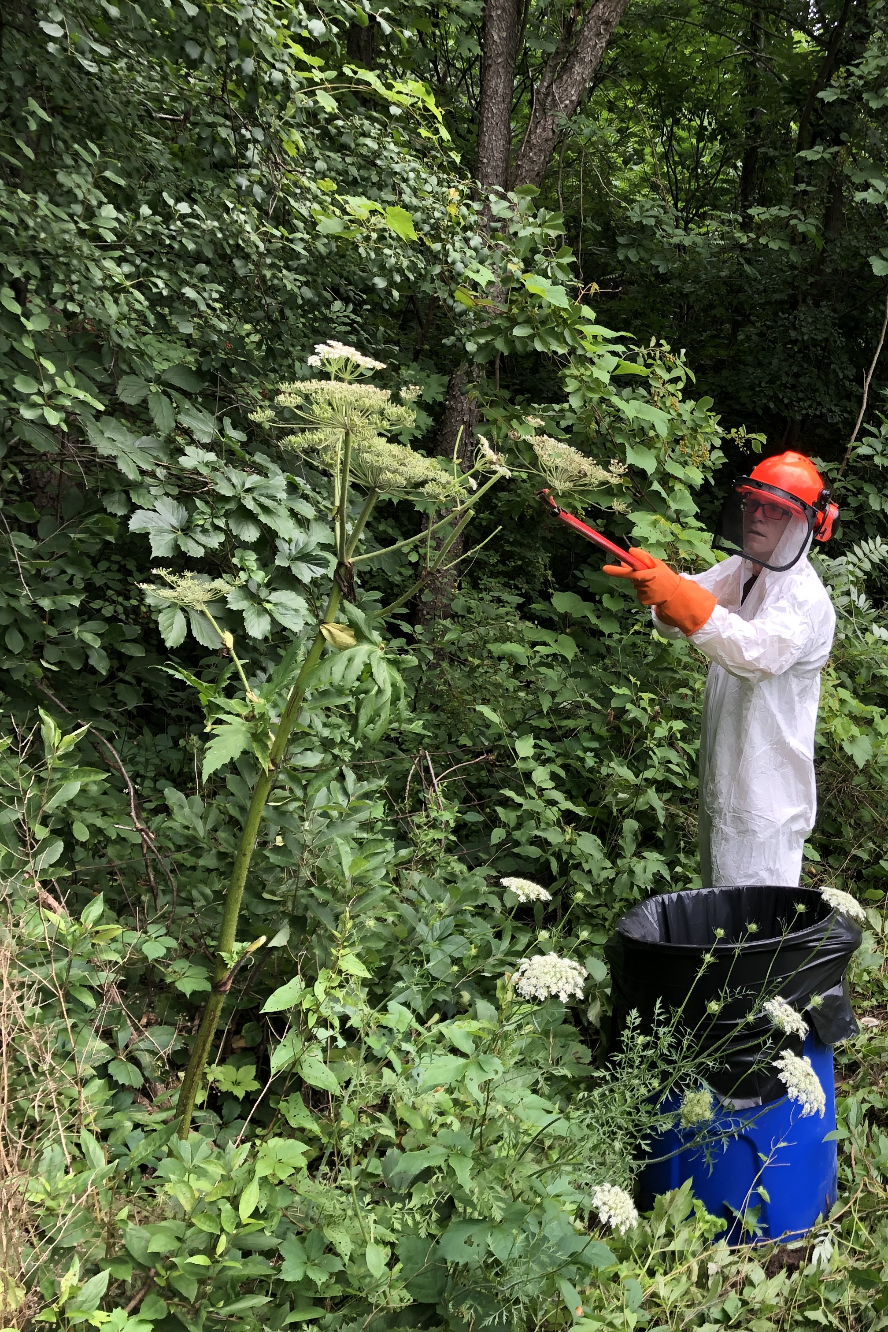
IPM Programs Combine Management Approaches for Greater Effectiveness.
Biological Control
  The use of natural enemies like predators, parasites, pathogens, and competitors to feed on or disrupt an invasive species. A form of control not eradication. Can provide long-term, widespread control.
Chemical Control
  Chemical control is the use of pesticides. Pesticides are selected and applied in a way that minimizes their possible harm to people, non-target organisms, and the environment.
Cornell College of Agricultural and Life Sciences Northeastern IPM Center

Slide 11
The PRISMS
Prioritize high threat invasive species with a low number of populations.
  Efforts are focused on conservation targets that are highly significant or protect rare and endangered species.
Prioritizes projects that have a high probability of success
  Seeking greatest impact with a limited capacity.
Prioritize efficient use of resources while providing the greatest return on work efforts.
  The Capital Region PRISM focuses on Priority Conservation Areas and Priority Waterbodies. Secondary sites are considered based on social, cultural, or partner priorities at the discretion of the PRISM.
Notes:
All of these management efforts are based on good data reporting.
The Tier Lists in Each PRISM and at the State Level Are Reviewed and Updated Annually.

Slide 12
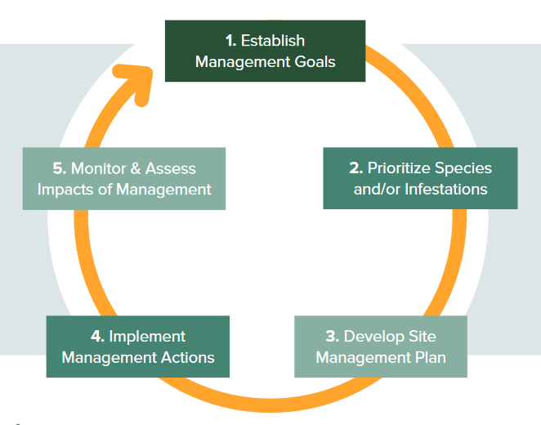
Management & Prioritization
Invasive Species Management is an ongoing, iterative process.
Five basic steps in management.
Consider the phenology of the plant and best time for treatment.
1. Goals
  Eradicate
  Contain
  Suppress
  Exclude
  Permitting & Permissions

Slide 13
Management & Prioritization
2. Prioritize Species and Infestations
  Utilize tier lists to determine regional concern
  Feasibility
  Commitment that will Result in Success

Slide 14
3. Develop Management Plan
  Timeline
  Best Management Practice
  Method (chemical/mechanical)
  Disposal
  Post-treatment monitoring

Slide 15
4. Implement Management Actions
Clean equipment and clothing to prevent spread
Alter plan as needed if things change
Restoration

Slide 16
5. Monitor and Assess Treatments
Record
-Stems or Percent Ground Cover Removed
Post Monitoring Checks
-Season and Annually
Assess for Restoration
Use Locally Native Replanting's
-Diverse plantings for resiliency

Slide 17
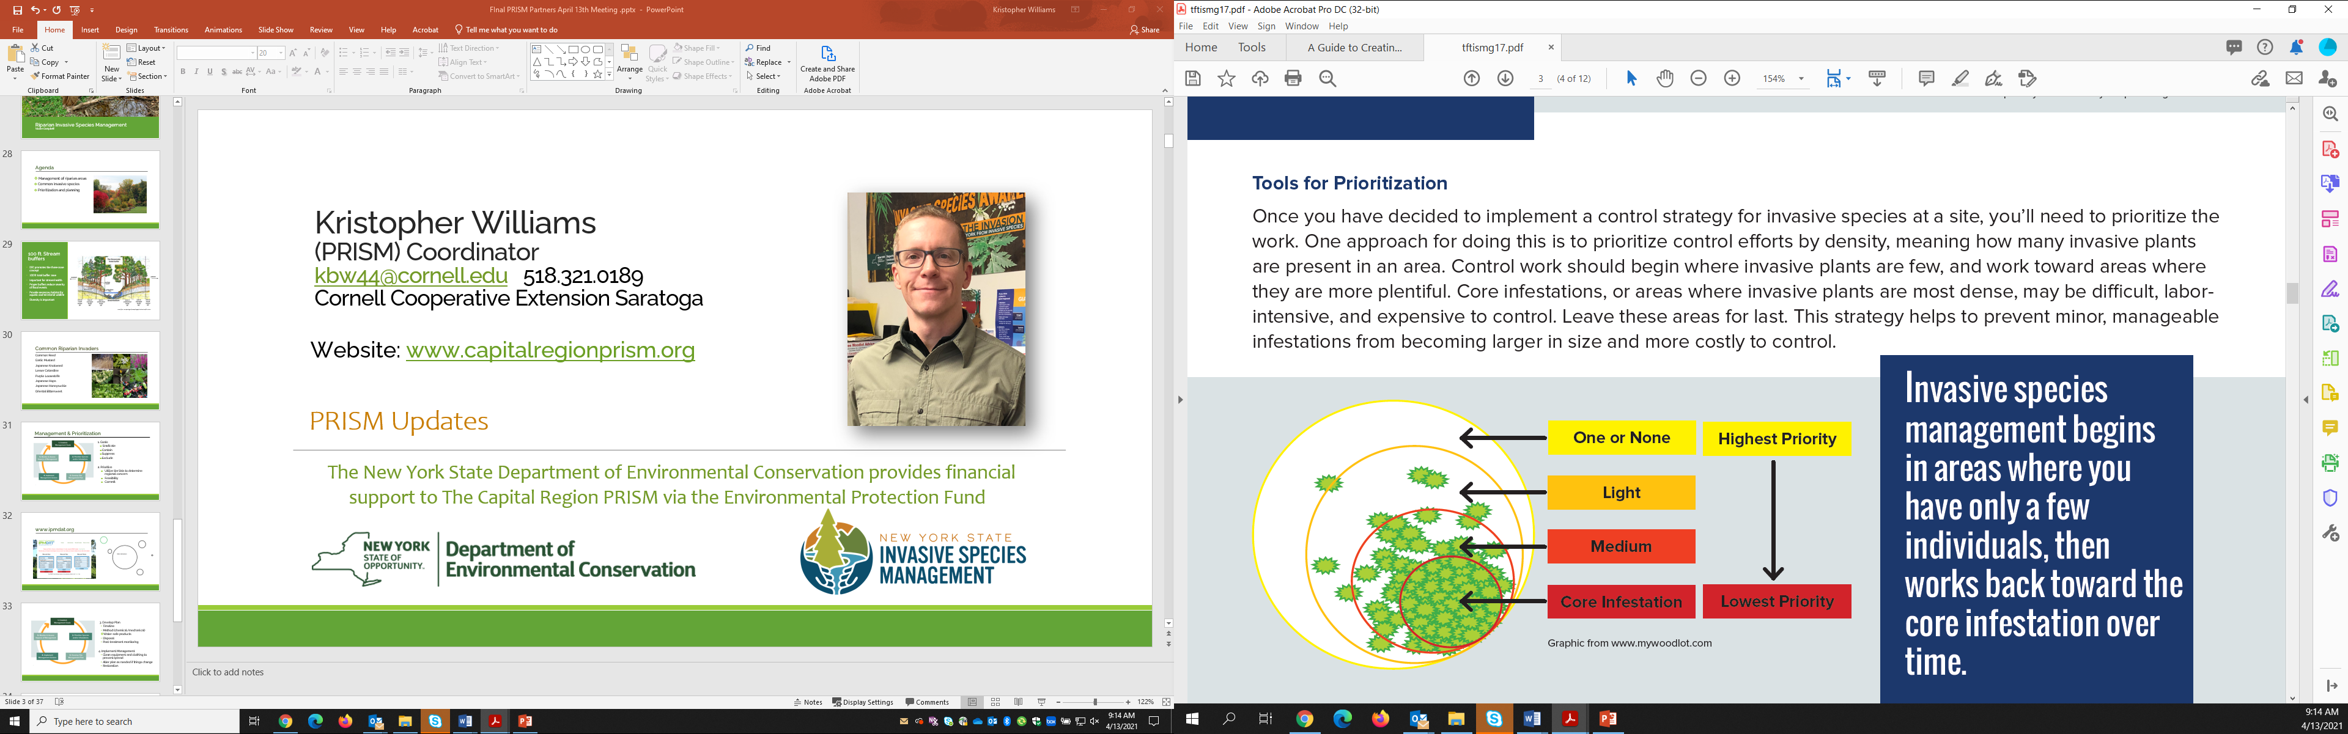
Prioritization
With a selected control strategy in hand prioritize the work effort. Start with low density satellite populations then into the core of the infestation.
    - Less difficult to more intensive, expensive and time consuming.
    - Strategy prevents minor, manageable infestations from becoming larger
The New York State Department of Environmental Conservation “Managing Invasive Plants In Riparian Areas

